Slide 1
CS246: Information Retrieval
Junghoo “John” Cho
UCLA

Slide 2
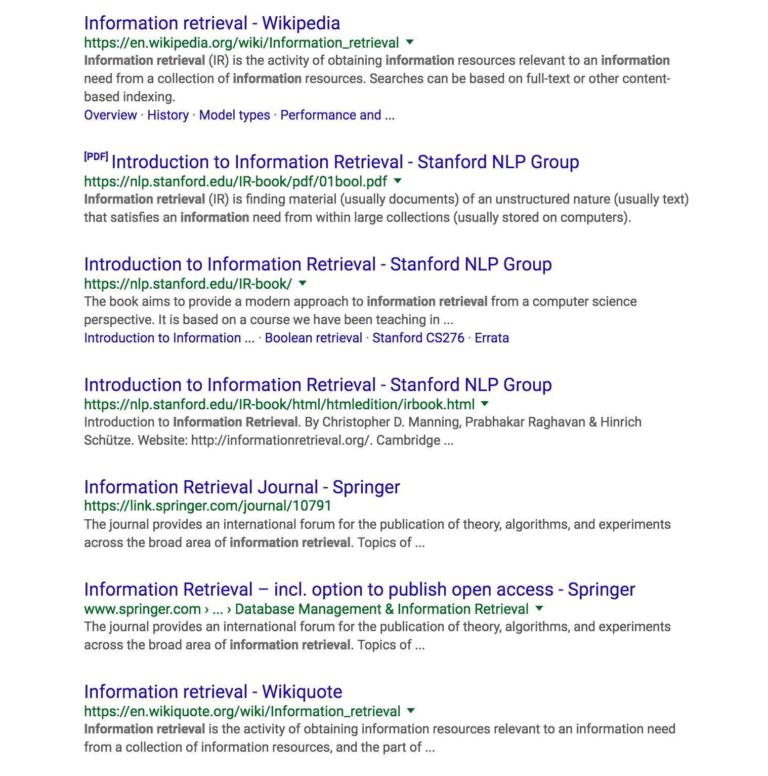
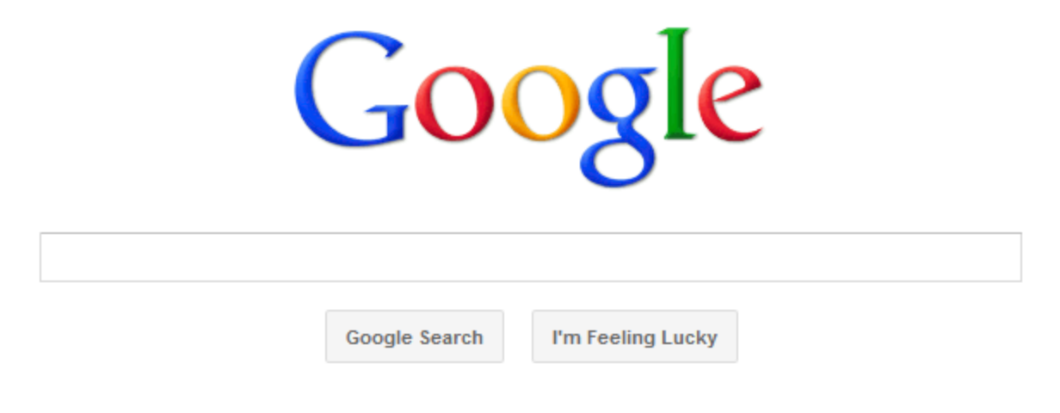
Web Search
User issues a “keyword” query
System returns “relevant” pages
information retrieval

Slide 3
Power of Search
Extremely intuitive: matches with “how we think”
Nothing to “learn”
Think about other “human-computer interfaces”: C, Java, SQL, HTML, GUI, …
Enormously successful
Made the Web useful practically for everyone with Internet access

Slide 4
Challenge
How can a computer figure out what pages are “relevant”?
Both queries and data are fuzzy
Unstructured text and natural-language query
What documents are good matches for a query?
Computers do not “understand” the documents or the queries
Fundamentally, isn’t relevance a subjective notion?
Is my home page relevant to “handsome man”?
AskArturo.com
We need a formal definition of our “search problem” to have any hope of building a system that does this
How can we formalize our problem?

Slide 5
Information-Retrieval Problem
Data source: a set of text documents
Vocabulary (= lexicon): $V=\left\{w_{1}, w_{2}, …w_{M}\right\}$
Document: $d_{i}=w_{i1}, w_{i2}, …w_{il_{i}}$
Collection (= corpus): $C=\{ d_{1},…, d_{N} \}$
Query: a sequence of words
Query: $q=w_{1},…, w_{l}$
Output: a set of documents
Set of “relevant” documents: $R\left(q\right)⊆C$
Document set returned by the system: $R′\left(q\right)⊆C$
We want to make $R′\left(q\right)$as close to $R\left(q\right)$as possible

Slide 6
What does “close” mean?
$R$: set of “relevant” document $R′$: set of documents returned by the system
Precision
Among the pages returned, what fraction is relevant?
$P= \frac{\left|R∩R′\right|}{\left|R′\right|}$
Recall
Among the relevant pages, what fraction is returned?
$R= \frac{\left|R∩R′\right|}{\left|R\right|}$

Slide 7
Evaluation: Precision and Recall
$\left|R\right|\text{=}5, \left|R′\right|$=10, $\left|R∩R′\right|$=3. What is precision and recall?

Slide 8
Precision-Recall Trade Off
Q: What is the easiest way to maximize recall?
Q: What is the easiest way to maximize precision?

Slide 9
Precision-Recall Trade Off
Return more documents
Higher recall
Lower precision
Depending on our setting, we get a curve of precision and recall
Q: Which algorithm is better?

Slide 10
F1 Score
Single metric combining precision and recall
$F1=2∙\frac{1}{\frac{1}{P}+\frac{1}{R}}$ $(0≤F1≤1)$
“Harmonic mean” of precision and recall
General F score is a “weighted version” of F1
$F=\frac{1}{α \frac{1}{P}+(1−α)\frac{1}{R}}=\frac{\left(β^{2}+1\right)PR}{β^{2}P+R}$ ($α=\frac{1}{1+β^{2}}$)

Slide 11
Where to Get Relevant Pages R?
How do we obtain the set of relevant pages $R$?
Option 1: Ask Arturo!!!
Option 2
Collect a large set of real queries and “relevant” pages from users
Evaluate the system based the collected “benchmark dataset” or “golden dataset”
Search engines dedicate enormous resources to build a high-quality benchmark dataset
Effectiveness of their system heavily depends on the quality of their benchmark data
Evaluation of IR system is fundamentally a subjective and empirical task, requiring human judgement

Slide 12
Back to IR Problem
Document: $d_{i}=w_{i1}, w_{i2}, …w_{il_{i}}$
Collection: $C=\{ d_{1},…, d_{N} \}$
Query: $q=w_{1},…, w_{l}$
Compute $R′(q)$
Q: How can the system compute $R′(q)$? How can we formulate this task as a computational problem?

Slide 13
IR as a Decision Problem
Given $q$, $∀d∈C,$decide whether $d∈R\left(q\right)$
More formally, we compute $R^{′}\left(q\right)$ $R^{′}\left(q\right)=\left\{ d∈C\right| f\left(d,q\right)=1\}$ where $f\left(d,q\right)→\{0,1\}$ is a binary classifier
Q: How can we build the classifier $f\left(d,q\right)→\{0,1\}$ ?

Slide 14
IR Problem: Ideal Solution
Apply natural language processing (NLP) algorithms to “understand” the “meaning” of the document and the query and decide whether they are relevant
Q: To understand the meaning of a sentence, what do we need to do?

Slide 15
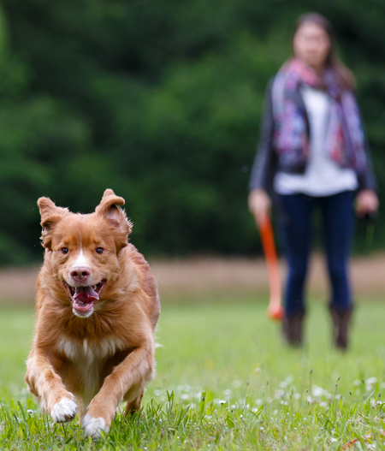
NLP Pipeline
Saw(a, _, _) => Had(a, b), Eye(b)
S
Inference
VP
Girl(a), Dog(b), Park(c), Saw(a, b, c)
VP
PP
Semantic analysis
NP NP NP
Syntactic analysis (parsing)
Det N V Det N P Det N Lexical analysis (POS tagging)
A girl saw the dog in the park.
Notes:
S: sentence
NP: noun phrase
VP: verb phrase
PP: prepositional phrase
Det: determiner
N: noun
V: verb
P: preposition

Slide 16
NLP: How Well Can We Do It?
Unfortunately, NLP is very, very hard
Lack of “background knowledge”
A girl is a female, a park is an outdoor space, …: How can a computer know this?
Many ambiguities
Was the girl in the park? Or the dog? Or both?
Ambiguities: example
POS: saw can be a verb or a noun. What is it?
Word sense: Saw has many meanings. What is it?
Parsing: “in the park” what does it modify?
Semantic: “the park” exactly what park?

Slide 17
NLP: Current State of Art
POS tagging: ~ 98% accuracy
Syntactic parsing: ~ 97%
Semantic analysis: partial “success” in very limited domains
Named entity recognition, Entity-relation extraction, sentiment analysis, … (~ 90%)
Inference: still very early stage
How do we represent “knowledge” and “inference rules”?
Ontology mismatch problem
Where do we obtain an ontology?
NLP is too premature to fully understand the meaning of a sentence yet
For search, only shallow NLP techniques are used as of now (if any)

Slide 18
Need for an “IR Model”
Q: What can we do? Any way to solve the IR problem?
Formulate the IR problem as a simpler computational problem based on simplifying assumption(s)

Slide 19
Simplifying Assumption: Bag of Words
Consider each document as a “bag of words”
“bag” vs “set”
Ignore word ordering. Just keep word count
Consider queries as a bag of words
Great oversimplification, but works well enough in many cases
“John loves only Jane” vs “Only John loves Jane”
The limitation still shows up on current search engines
Still, how do we match documents and queries?

Slide 20
Simplifying Assumption: Boolean Model
Return the documents that contain the words in the query
“Boolean assumption”: a document is either “relevant” or “irrelevant”
No notion of “ranking”
Simplest “model” for information retrieval
Q: How to find and return matching documents?
Basic algorithm?
Useful data structure?
Scalability problem
Takes too long to run. Any way to speed up the computation?
Q: What is the key information that we need to compute $R′(q)$?

Slide 21
Inverted Index
Allows quick lookup of document ids with a particular word
Q: How can we use this to answer “UCLA Physics”?
Postings list
lexicon/dictionary V
3 | 8 | 10 | 13 | 16 | 20
PL(Stanford)
Stanford
1 | 2 | 3 | 9 | 16 | 18
PL(UCLA)
UCLA
MIT
4 | 5 | 8 | 10 | 13 | 19 | 20 | 22
PL(MIT)
…

